Slide 1
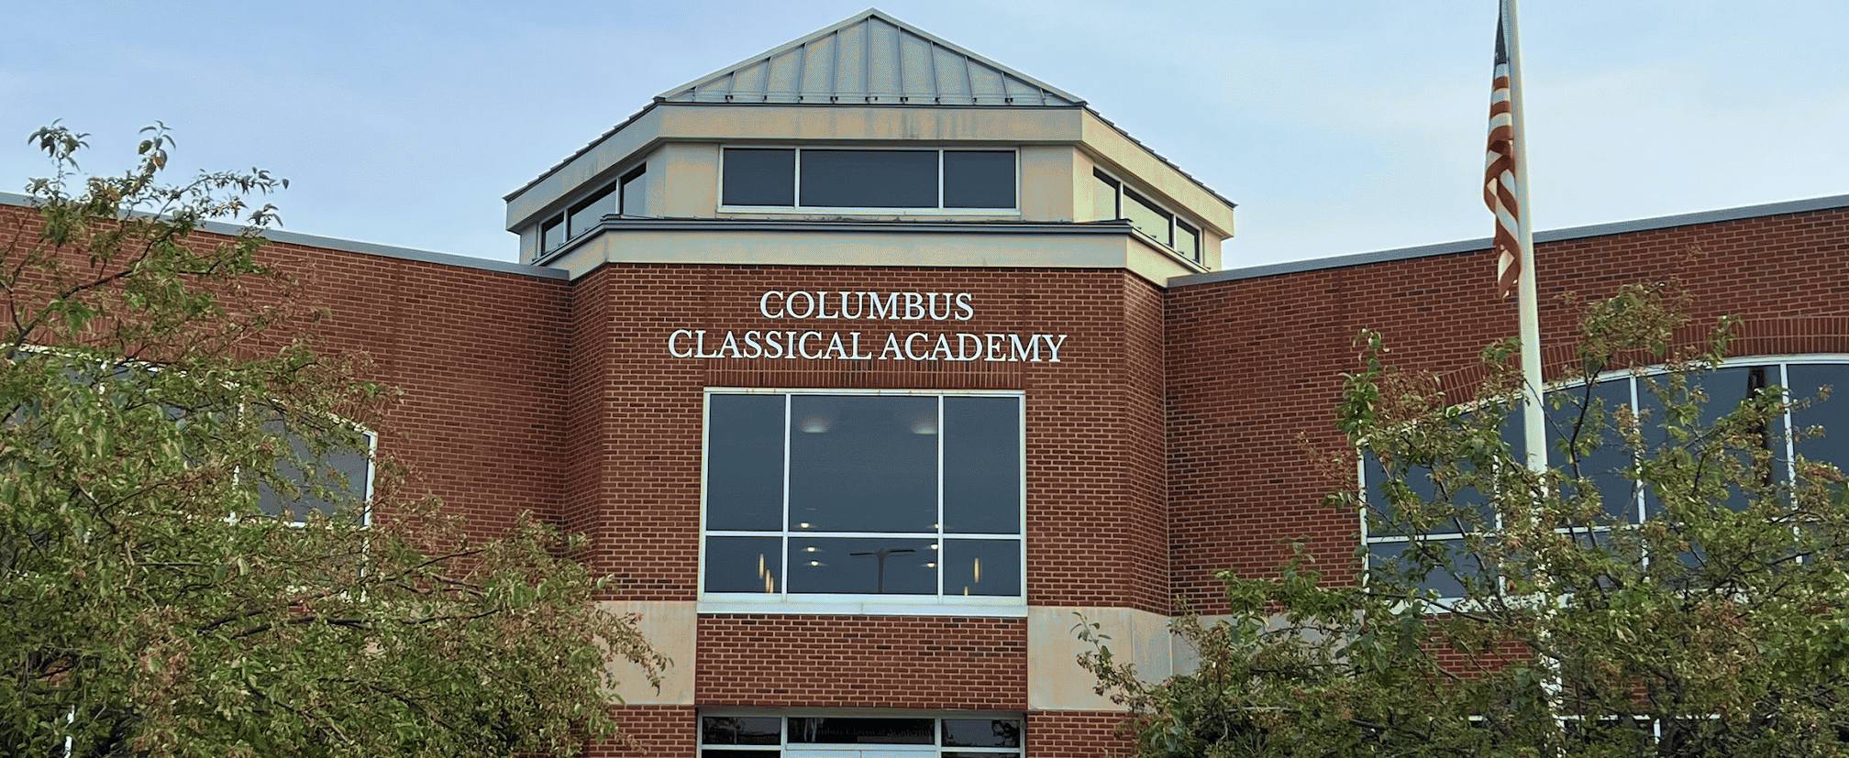

KINDERGARTEN
GRADES 6-9
GRADES 1-5
GRADES 9-12
GRADES 6-10
GRADES 6-11
GRADES 6-12

